Slide 1
Directory Hierarchy
By Mihir, Mansi, Muskan & Mahek

Slide 2

Introduction
The Unix file system is a hierarchical, tree-structured file system used in Unix-like operating systems, including Linux and macOS. It provides a way to organize and manage files and directories on a computer. The file system is designed to be flexible and efficient, allowing users to easily access and manipulate data. It is one of the most enduring and influential file system designs, and its principles have inspired numerous other file systems.

Slide 3
Directories In Unix
Root Directory The root directory, represented by a forward slash (/), is the top-level directory of the Unix file system. It contains all other directories and files in the system.
Subdirectories Directories can be nested within one another, creating a tree-like structure. For example, the /home directory might contain subdirectories for each user on the system.
Filenames in Unix
File Names Each file within a directory has a unique name. File names are case-sensitive, meaning that "document.txt" and "Document.txt" are considered different files

Slide 4
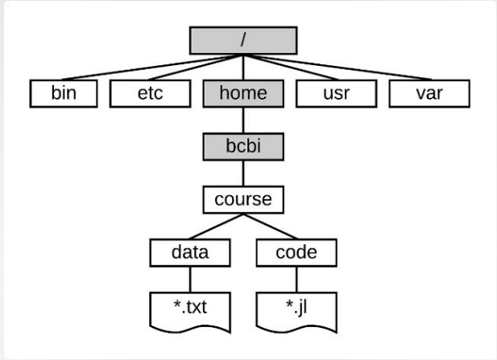
Directory Hierarchy
In Unix and Unix-like operating systems, the directory hierarchy is organized in a tree-like structure starting from the root directory (/). Below is an overview of the typical Unix directory hierarchy:

Slide 5
Key Directories:
/ (Root Directory):
The top of the hierarchy; every other file or directory starts from here.
/bin (Essential User Binaries):
Contains essential command binaries (like ls, cp, mv, cat, etc.) that are needed in single-user mode and must be available to all users.
/etc (Configuration Files):
Stores system-wide configuration files and shell scripts used for booting and system initialization (e.g., /etc/passwd, /etc/fstab).
/home (User Home Directories):
Contains personal directories for all users. For example, /home/user1 is the home directory for user1.
/usr (User Binaries and Read-Only Data):
Contains user programs and utilities that are not essential for booting or repairing the system. It has subdirectories like /usr/bin, /usr/lib, /usr/share, etc.
/var (Variable Data Files):
Contains files that are expected to grow or change frequently, such as logs, mail spools, and temporary files created by users.

